Slide 1
Course Map
Data Gathering
Classify Data
Data Exploration
Picturing Distributions with Graphs
Scatterplots and Correlation
Probability and Distributions
Introducing Probability
Sampling Distributions
Inferences about a Population Mean
Inference
Sampling
Describing Distributions with Numbers
Experiments
Binomial Distributions
General Rules of Probability
Inferences about a Population Proportion
Confidence Intervals
Hypothesis Testing
Goals of Statistics
Regression
Normal Distributions
Practicing Statistics

Slide 2

Today You will be able to…
Chapter 9
Distinguish between observations and experiments
Identify subjects, factors, and treatments
Describe how to experiment badly
Design randomized comparative experiments
Describe cautions about experimentation
Course Map

Slide 3
Do you think smoking causes cancer and other diseases?
Chapter 9
Course Map

Slide 4
Observation vs. Experiment
An observational study observes individuals and measures variables of interest but does not attempt to influence the responses. The purpose is to describe some group or situation.
An experiment deliberately imposes some treatment on individuals to measure their responses. The purpose is to study whether the treatment causes a change in the response.
Chapter 9
When our goal is to understand cause and effect, experiments are the only source of fully convincing data.
The distinction between observational study and experiment is one of the most important in statistics.
Course Map

Slide 5
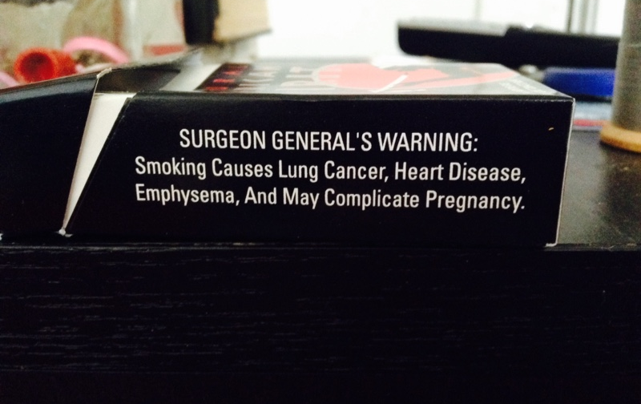
Do you think smoking causes cancer and other diseases?
Chapter 9
Course Map

Slide 6
9.1 Cell Phones & Brain Cancer
A study of cell phones and the risk of brain cancer looked at a group of 469 people who have brain cancer. The investigators matched each cancer patient with a person of the same sex, age, and race who did not have brain cancer, then asked about use of cell phones. Result: “Our data suggest that use of handheld cellular telephones is not associated with the risk of brain cancer.”
Is this an observational study or an experiment? Why?
Observational - No treatment was assigned to the subjects; researchers merely observed cell phone usage and presence/absence of cancer
What are the explanatory and response variables?
The explanatory variable is cell phone usage, and the response variable is whether or not a subject has brain cancer.
Chapter 9
Course Map

Slide 7
9.3 Quitting Smoking & Diabetes
Researchers studied a group of 10,892 middle-aged adults over a period of nine years. They found that smokers who quit had a higher risk for diabetes within 3 years of quitting than either nonsmokers or continuing smokers. Does this show that stopping smoking causes the short-term risk for diabetes to increase?
FACT: Weight gain is a major risk factor for developing type 2 diabetes and is a side effect of quitting smoking.
Should you tell a middle-aged adult who smokes that quitting smoking can cause diabetes? Should you advise him or her to continue smoking?
This is an observational study, so it is not reasonable to conclude any cause-and-effect relationship. At best, we might advise smokers that they should be mindful of potential weight gain and its accompanying ailments.
Chapter 9
Course Map

Slide 8
Confounding
A confounding variable is an extraneous variable that is related to both the explanatory and response variables.
Well-designed experiments take steps to avoid confounding.
Chapter 9
Course Map

Slide 9
Confounding Example
The State Department of Developmental Services (DDS) for a particular state is responsible for allocating funds that support over 250,000 developmentally disabled residents.
Chapter 9
Average Expenditures to Individuals with Disabilities
White non-Hispanic |  | Hispanic
Mean | Standard Deviation | Mean | Standard Deviation
$24,678 | $20,604 | $11,066 | $15,630
Course Map

Slide 10
Confounding Example
Average Expenditures to Individuals with Disabilities by Age Group
Age Group | White non-Hispanic |  | Hispanic
 | Mean | Standard Deviation | Mean | Standard Deviation
0-5 | $1,393 | $533 | $1,367 | $716
6-12 | $2,312 | $823 | $2,052 | $843
13-17 | $3,955 | $939 | $3,904 | $1,071
18-21 | $9,960 | $3,231 | $10,133 | $2,706
22-50 | $40,924 | $6,467 | $40,188 | $6,081
51+ | $55,585 | $5,390 | $52,670 | $6,425
Chapter 9
Age is a confounding variable.
Age is related to the explanatory variable because each subject has an age.
Age is related to the response variable because the amount of financial support depends on the age of the subject.
Course Map

Slide 11
Subjects, Factors, Treatments
The individuals studied in an experiment are called experimental units or subjects (if they are human)
The explanatory variables in an experiment are often called factors.
A treatment is a specific condition applied to the experimental units or subjects.
Medication
Physical Therapy
Counseling
Sunlight
Early childhood intervention
Chapter 9
Course Map

Slide 12
9.4 Ginkgo Extract & Post-lunch Dip
Identify the observational units(s), factor(s), treatment(s), and response variable(s):
The post-lunch dip is the drop in mental alertness after a midday meal. Does an extract of the leaves of the ginkgo tree reduce the post-lunch dip? Assign healthy people aged 18 to 40 to take either ginkgo extract or a placebo pill. After lunch, ask them to read seven pages of random letters. Mark the instances of the letter ‘e’ and count the number of times the letter was missed.
Subjects: the “healthy people aged 18 to 40.”
Factor: the pill given to the subject.
Treatments: ginkgo or placebo.
Response variable: the number (or fraction) of e’s identified by each subject.
Chapter 9
Course Map

Slide 13
9.5 Growing in the Shade
Identify the observational unit(s), factor(s), treatment(s), and response variable(s):
Ability to grow in shade may help pines found in the dry forests of Arizona resist drought. How well do these pines grow in shade? Plant pine seedlings in a greenhouse in either full light, light reduced to 25% of normal by shade cloth, or light reduced to 5% of normal. At the end of the study, dry the young trees and weigh them.
Observational units: pine seedlings.
Factor: amount of light.
Treatments: full light, 25% light, or 5% light.
Response variable: dry weight at the end of the study.
Chapter 9
Course Map

Slide 14
How to Experiment Badly
Experiments are the preferred method for examining the effect of one variable on another.
By imposing the specific treatment of interest and controlling other influences, we can pin down cause and effect.
Good designs are essential for effective experiments, just as they are for sampling.
Chapter 9
Course Map

Slide 15
How to Experiment Badly
A college regularly offers a review course to prepare students for the GMAT. This year, budget cuts will allow the school to offer only an online version of the course.
Students → Online Course → GMAT Scores
The average GMAT score of students in the online course is 10% higher than the long-time average for those who took the classroom review course.
Is the online course more effective?
Chapter 9
Course Map

Slide 16
How to Experiment Badly
Field experiments and experiments with animals or people deal with more variable conditions. (Ex. age, health history, demographics)
Students in the online GMAT review course were older and more likely to be employed than students who took the classroom version in the past.
Outside the laboratory, badly designed experiments often yield worthless results because of confounding.
Chapter 9
Course Map

Slide 17
Example 9.3 (page 226)
What are the effects of repeated exposure to an advertising message?
The answer may depend both on the length of the ad and how often it is repeated.
Design an experiment where subjects will view a 40-minute TV program that includes ads for a digital camera.
Two versions of the commercial, one 30-second and one 90-second, are to be shown to different subjects during the program.
Subjects will also view their assigned version 1, 3, or 5 times during the program.
How many factors does this study have?
Two
How many values does each factor take?
The factor ‘length’ takes one of two 2 values.
The factor ‘repetitions’ takes one of 3 values.
Chapter 9
Course Map

Slide 18
Randomized Comparative Experiments
Compare two or more treatments
Randomly assign subjects to each treatment group
If groups differ greatly (age, gender, race) the results will be biased.
Randomization reduces or eliminates bias.
Randomization averages out the effects of confounding variables and allows an unbiased comparison of the treatments.
Use enough experimental units, called replicates, in each group to reduce chance variation in the results.
Chapter 9
Course Map

Slide 19
Randomized Comparative Experiments
In a completely randomized design, the treatments are assigned to all the experimental units completely by chance.
Some experiments may include a control group that receives an inactive treatment or an existing baseline treatment.
Chapter 9
Group 1
Treatment 1
Compare Results
Experimental Units
Random Assignment
Group 2
Treatment 2
Course Map

Slide 20
Randomized Comparative Experiments
Randomly assigning students to the two groups controls for confounding factors such as age, income, experience, etc.
Chapter 9
Group 1
Classroom Course
Compare Results
Students taking GMAT
Random Assignment
Group 2
Online Course
Course Map

Slide 21
Results of Randomized Comparative Experiments
Well-designed experiments give good evidence that differences in the treatments actually cause the differences seen in the response.
An observed effect from a treatment so large that it would rarely occur by chance is called statistically significant.
A statistically significant association in data implies causation.
Chapter 9
Course Map

Slide 22
Cautions About Experimentation
The logic of a randomized comparative experiment depends on our ability to treat all the subjects the same in every way except for the actual treatments being compared.
Chapter 9
In a double-blind experiment, neither the subjects nor those who interact with them and measure the response variable know which treatment a subject received.
Course Map

Slide 23
Block Designs
A block is a group of individuals that are known before the experiment to be similar in some way that is expected to affect the response to the treatments.
In a block design, the random assignment of individuals to treatments is carried out separately within each block.
Examples
Block 1: Males; Block 2: Females
Block 1: Ages 5-12; Block 2: Ages 13-18; Block 3: Ages 19-26
Chapter 9
Course Map

Slide 24
Matched Pairs Design
Compares two treatments
Match subjects based on similar characteristics
Use chance to assign which one of the pair receives treatment 1 and then the other receives treatment 2
Also use matched pairs in observational studies
Chapter 9
Course Map

Slide 25
Objectives Review
Distinguish between observations and experiments
Identify subjects, factors, and treatments
Describe how to experiment badly
Design randomized comparative experiments
Describe cautions about experimentation
Chapter 9
Course Map

